Slide 1
Medical Cost Prediction
Using Linear Regression

Slide 2



Our Team
Kinjal Shah
Karan Ghadge
Rashi Sharma

Slide 3
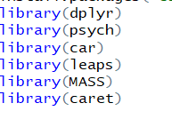
Libraries Used

Slide 4
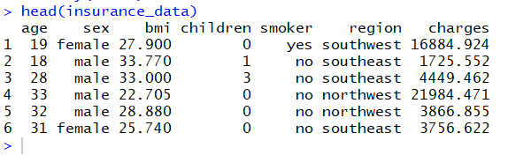
About the Dataset
Data source :
https://www.kaggle.com
Data overview:

Slide 5


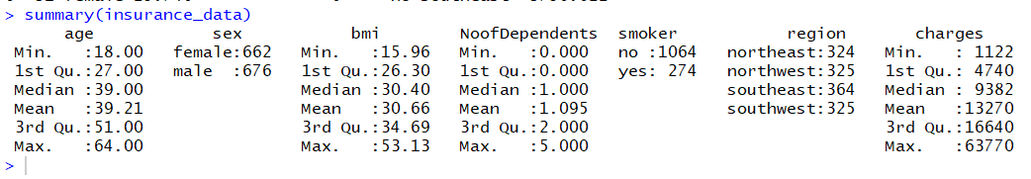
Data Validation
Check for null values:
Checking for bad data:

Slide 6
Exploratory Data Analysis

Slide 7
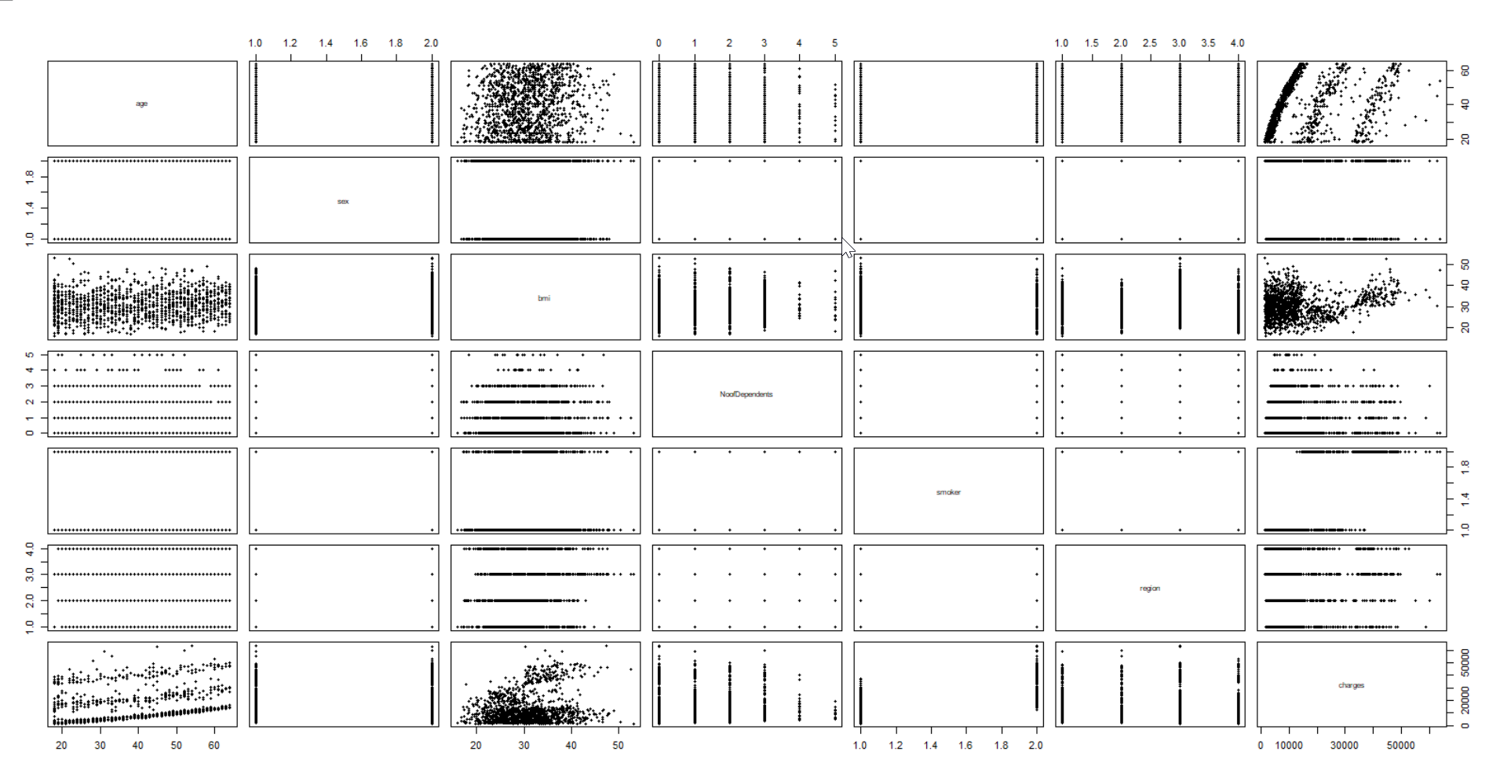
Scatter plot of variables

Slide 8
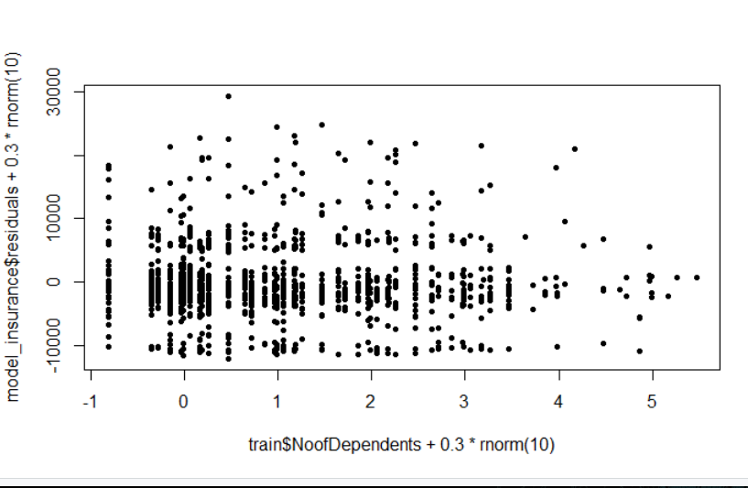
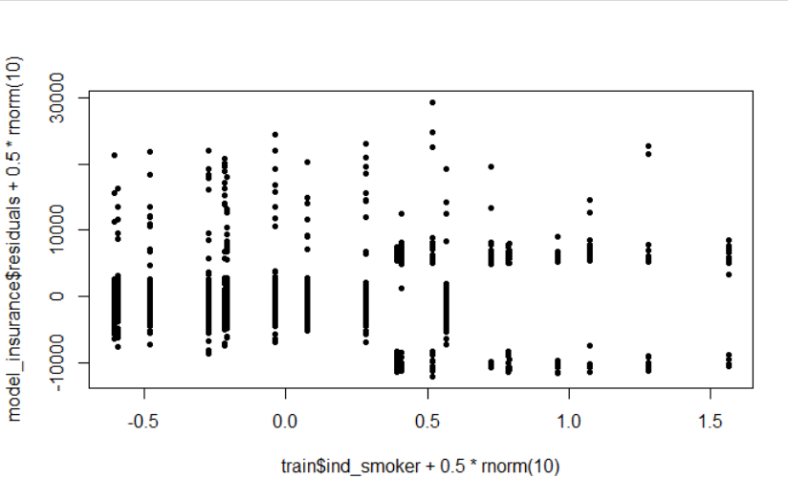
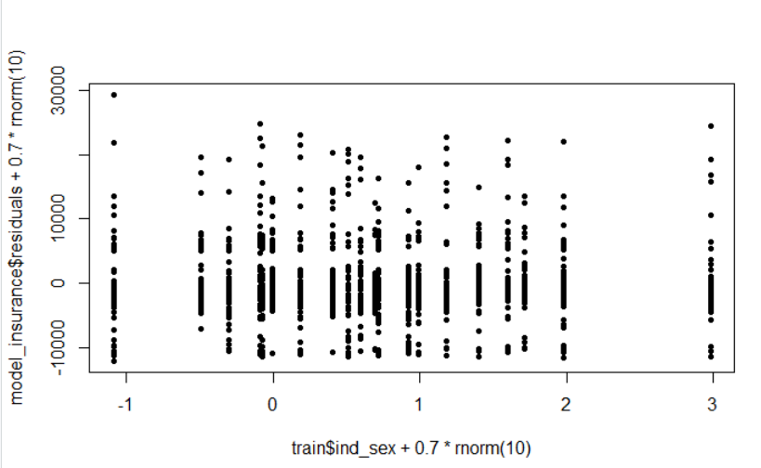
Scatter plot of variables
Created jitter plots for sex, no. of dependents and smoker

Slide 9
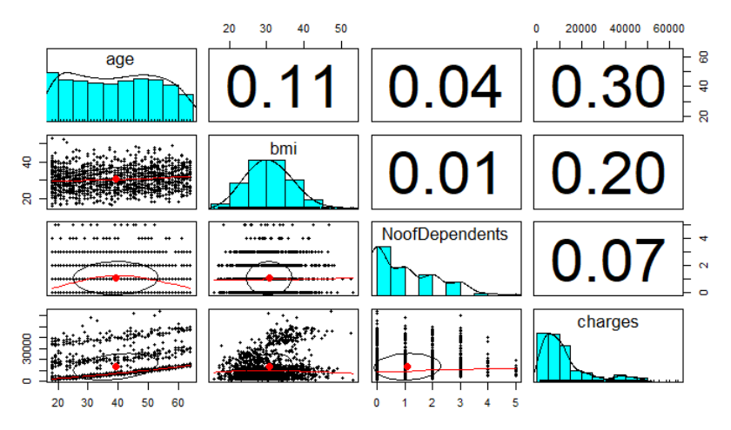
Histograms and correlations

Slide 10
Feature Engineering

Slide 11
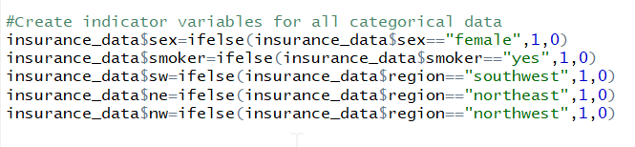
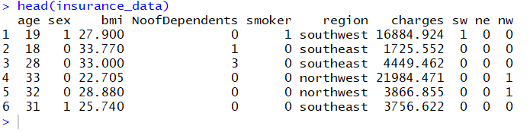
Convert categorical variables to numeric
Created indicator variables for covariates “smoker”, “sex” and “region”

Slide 12
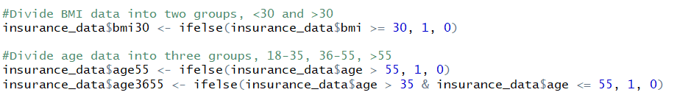
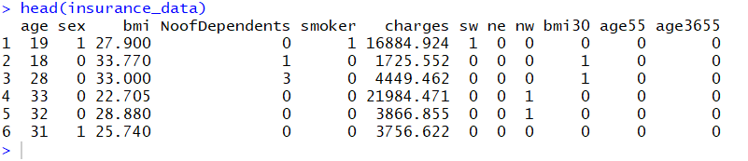
Manufacturing new features
Created new features based on the clusters in bmi and based on age.

Slide 13
Split the data into training and test

Slide 14
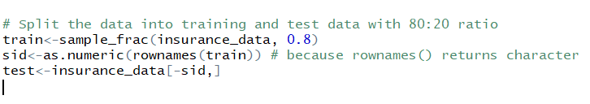
Split the dataset into train and test
Used 80:20 ratio to split the train and test data

Slide 15
Model Creation

Slide 16
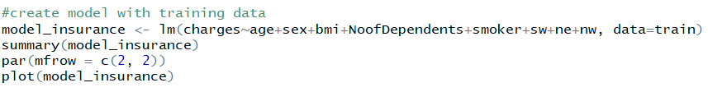
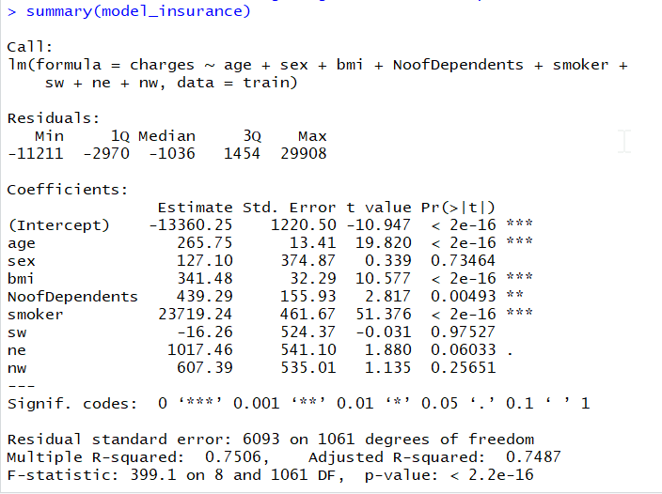
Data Model 1
R-square = 0.751, Adjusted R-square = 0.749, p-value~0

Slide 17
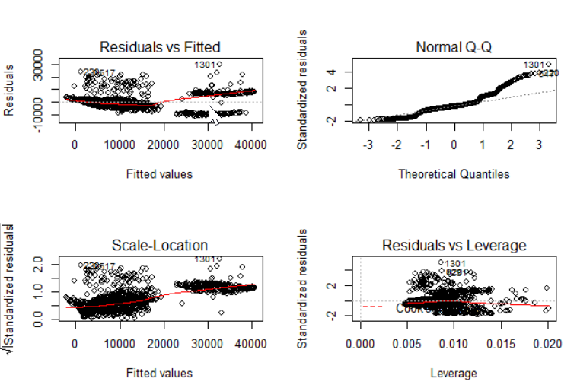
Model 1 (continued)

Slide 18
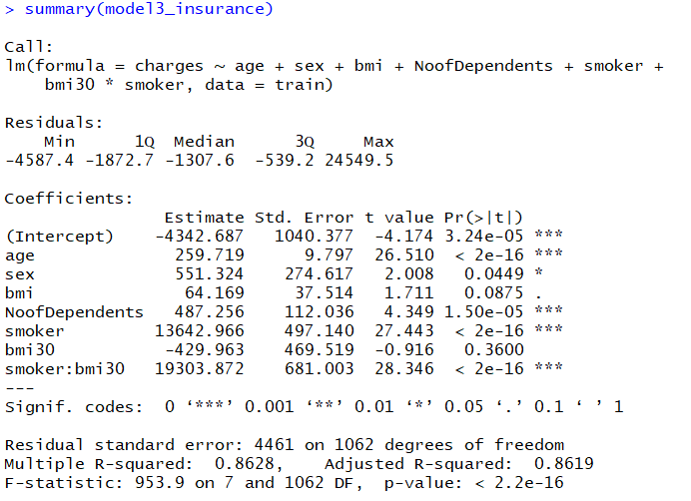
Data Model 2 (Added interaction)
R-square = 0.863, Adjusted R-square = 0.862, p-value~0

Slide 19
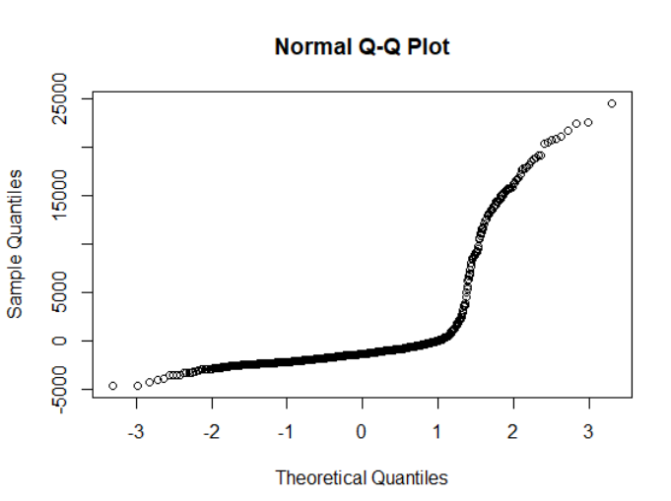
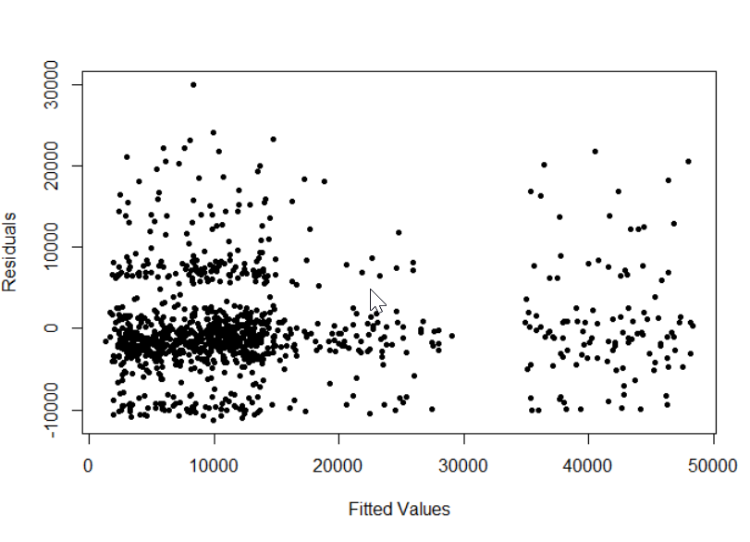
Residual plot for Model 2

Slide 20
Transformation

Slide 21
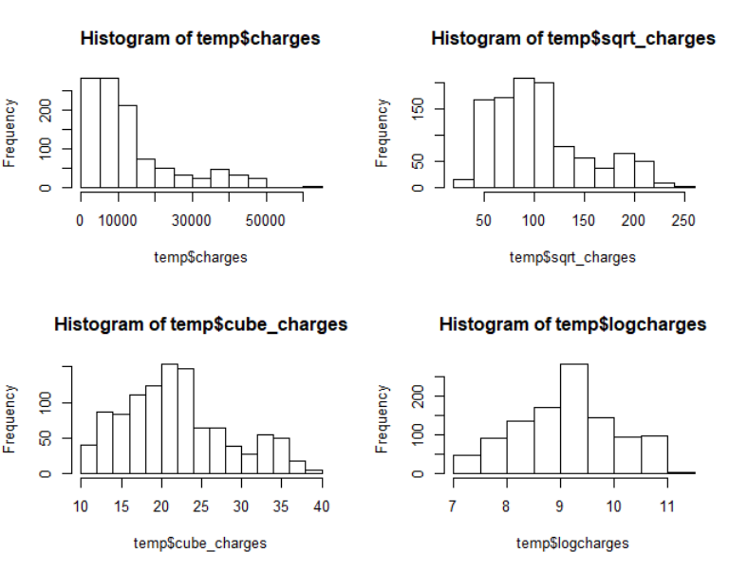
Transformations on y – square-root, cube-root and log

Slide 22

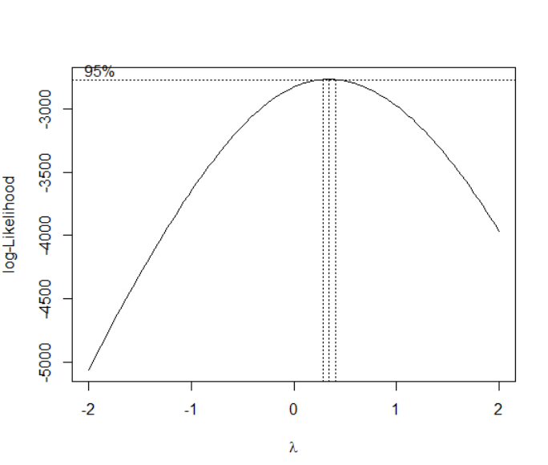
Box Cox Transformation

Slide 23
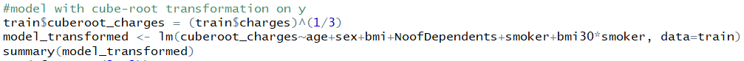
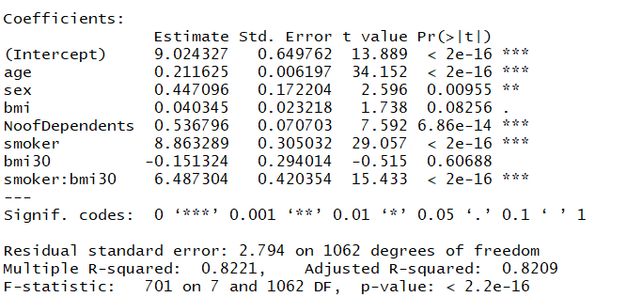
Transformed model
New model is created with cube root transformation.
Adjusted R-square decreased from 0.86 to 0.82

Slide 24
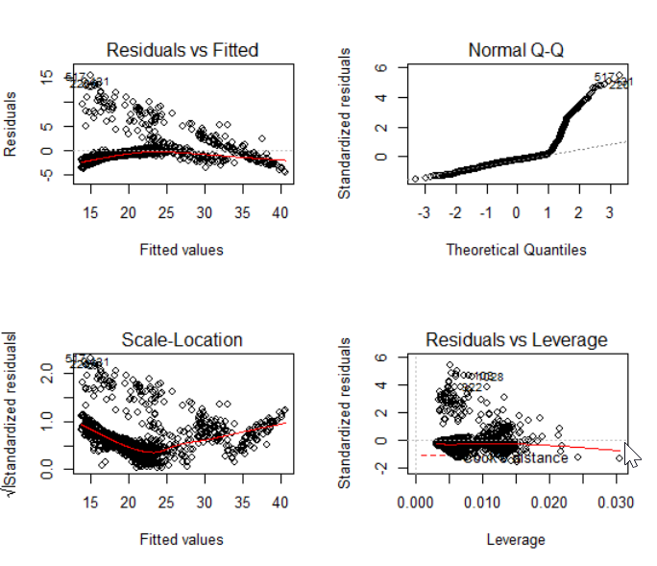
Plotting the transformed model
Normality solved but inequality of variance increased. It is not helping with getting linear QQ-plot as well. So will NOT GO WITH TRANSFORMATION.

Slide 25

Multi Collinearity Test
VIF<10. So no multi collinearity.

Slide 26
Variable Selection using Stepwise Regression

Slide 27
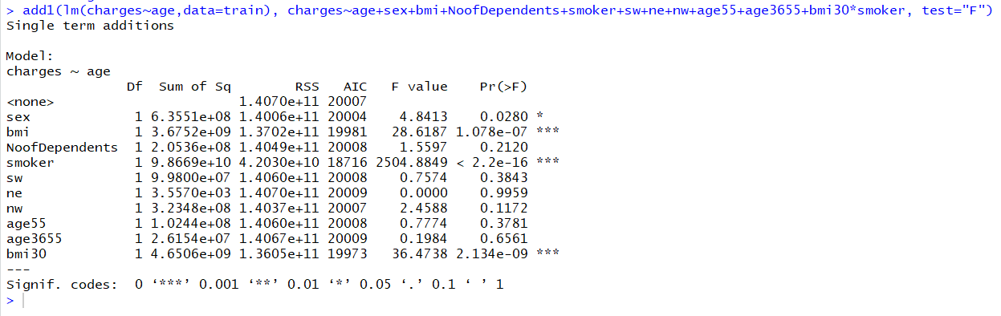
Variable selection – Stepwise Regression
Forward Selection
Adding Age

Slide 28
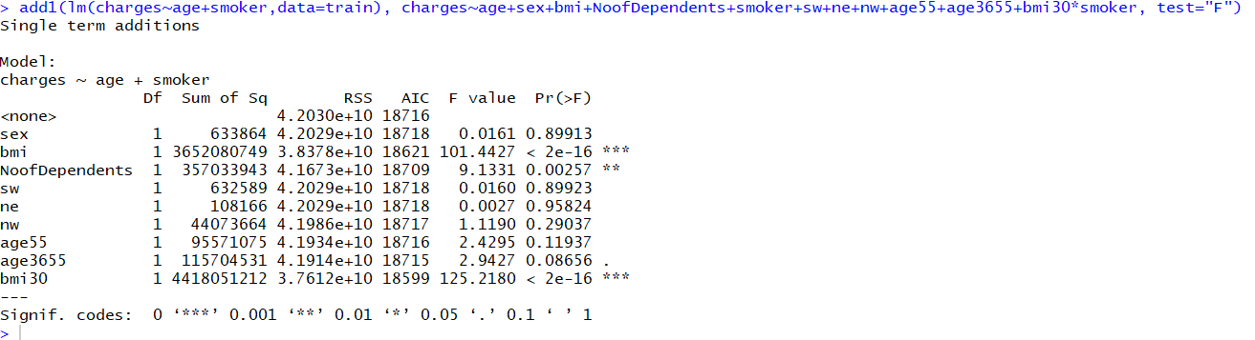
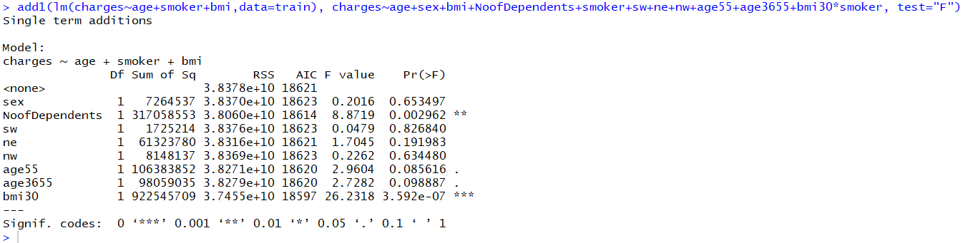
Adding smoker
Adding bmi

Slide 29
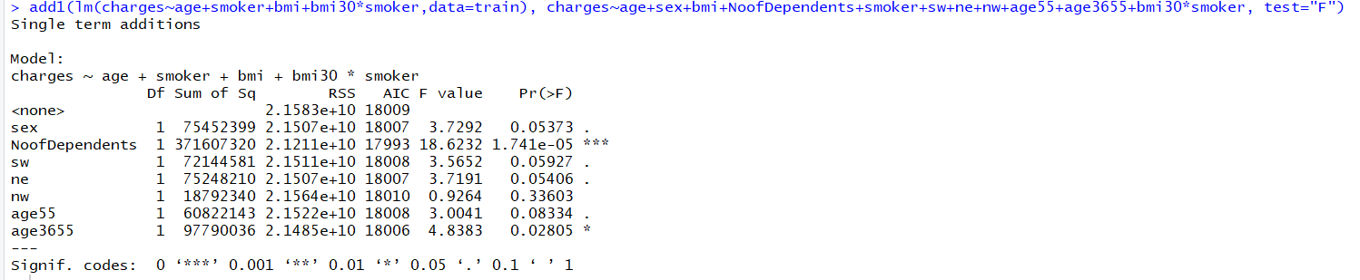
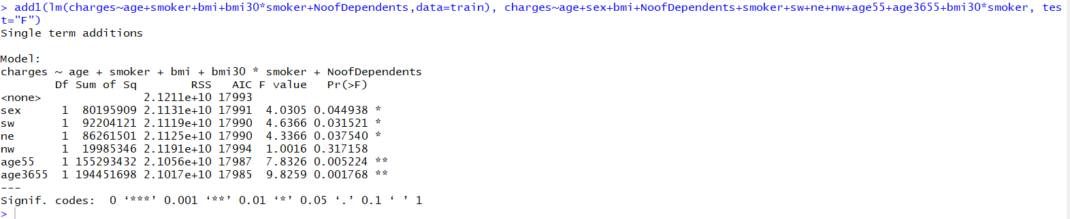
Adding interaction between smoker with bmi30
Adding Number of dependents

Slide 30
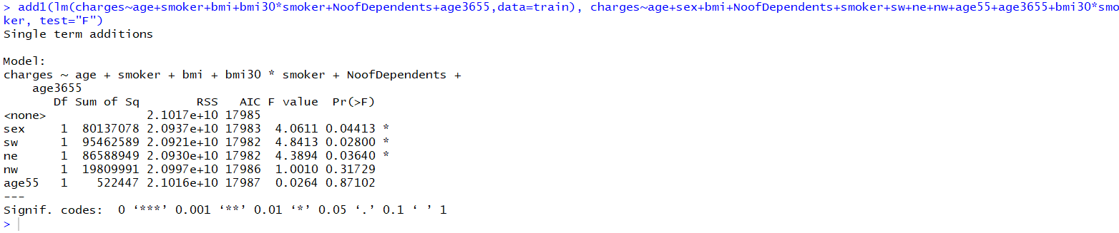
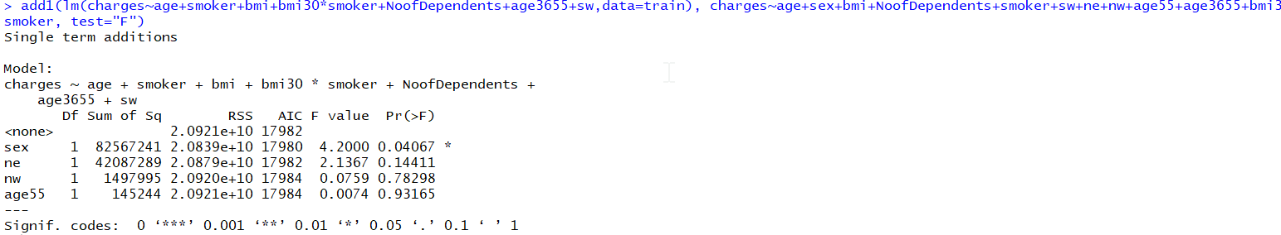
Adding age 3655
Adding sw

Slide 31
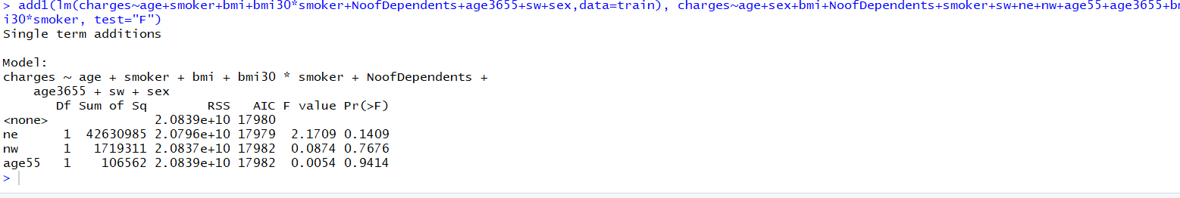
Adding sex

Slide 32
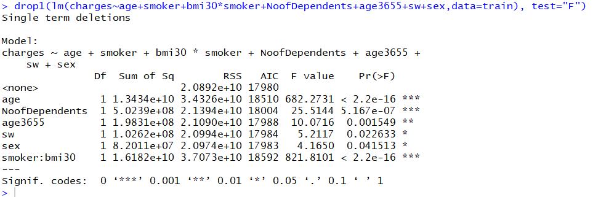
Variable selection
Backward Selection
Removing BMI

Slide 33
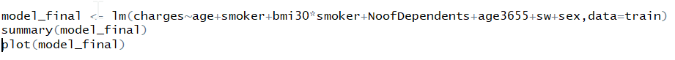
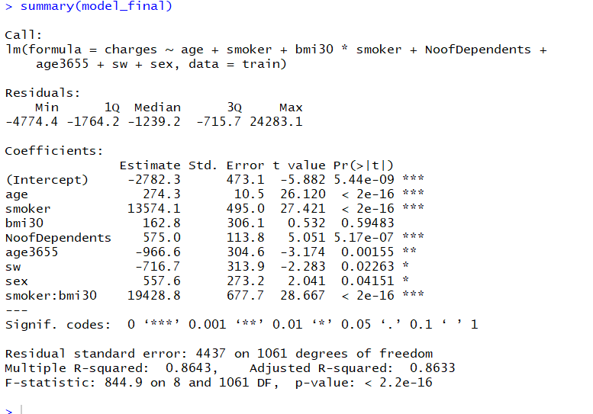
Making Final Model
Adjusted R-square increased from 0.862 to 0.8633

Slide 34
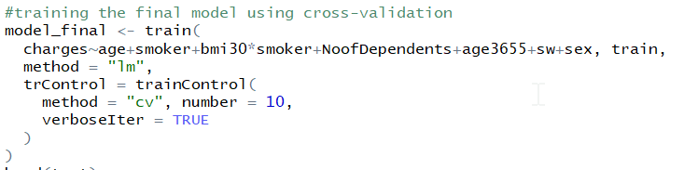
Training final model using 10 fold cross-validation

Slide 35
Predicting test data

Slide 36

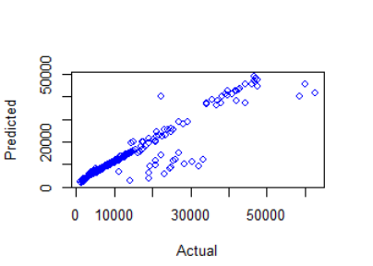
Testing Model

Slide 37
Challenges faced by us
1
3 qualitative values
2
Finding the right interaction between covariates
3
Highly right-skewed response variable

Slide 38
Thank You

